Slide 1

Take a look. Read a book.
FUTURE Program 4.0 – Phase 1

Slide 2


HELLO!
Andrew Wijaya
Syntia
TIM MEDAN

Slide 3

Why?
1
E-book rather than printout book?

Slide 4
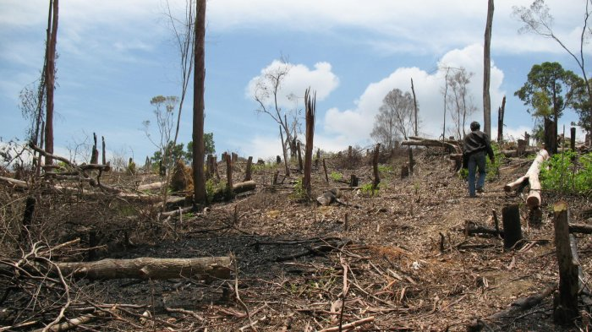
13,407,393,220 trees
490,000,000 tons
2020
are needed to produce
of paper estimated in
- Indonesian Pulp and Paper Association (APKI), 2019

Slide 5
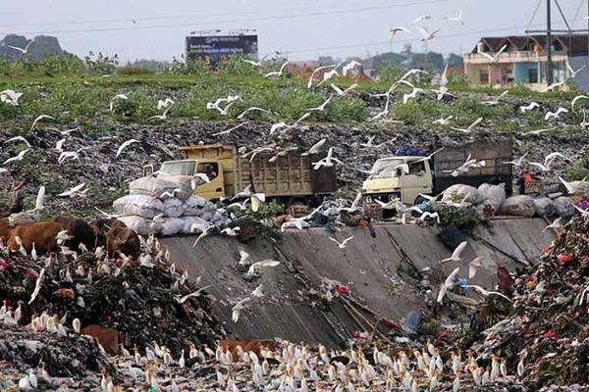
1,350,000 tons of paper
EVERYDAY
polluting the Indonesian ecosystems
- Sustainable Waste Indonesia (SWI), 2017

Slide 6
Books should cost less and they should be digital.
— Walt Mossberg

Slide 7
What?
2
Is the solution?

Slide 8
BOOKMART
Digital Book Market that provides e-book around the world!

Slide 9


Benefits
Read your books on any device!
Read book everytime, everywhere
Save money and save our world!
📖
24h

Slide 10
How?
3
It works?

Slide 11
User (Customer)
I can choose books and search for it
I can buy books.
I can read my books.

Slide 12
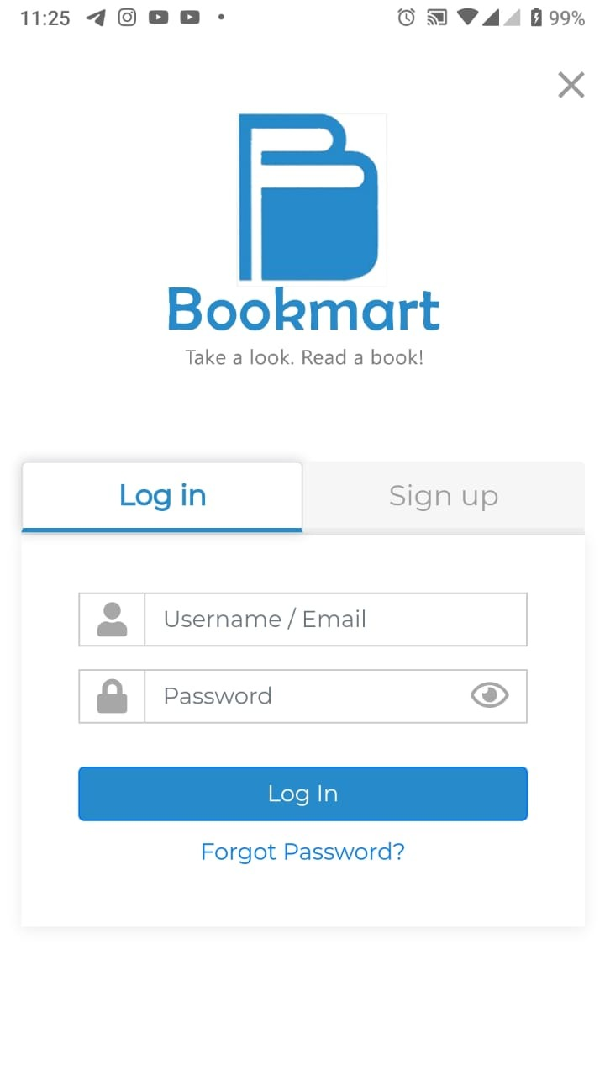
Log in
Log in to Bookmart websites using user account

Slide 13
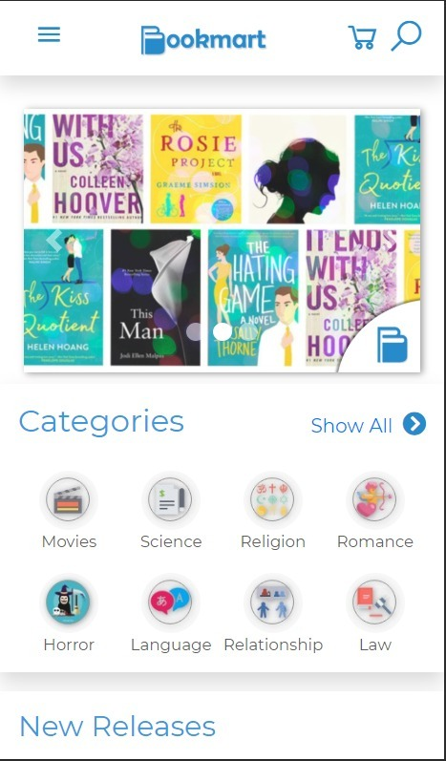
Register
Register to make new account in Bookmart.

Slide 14
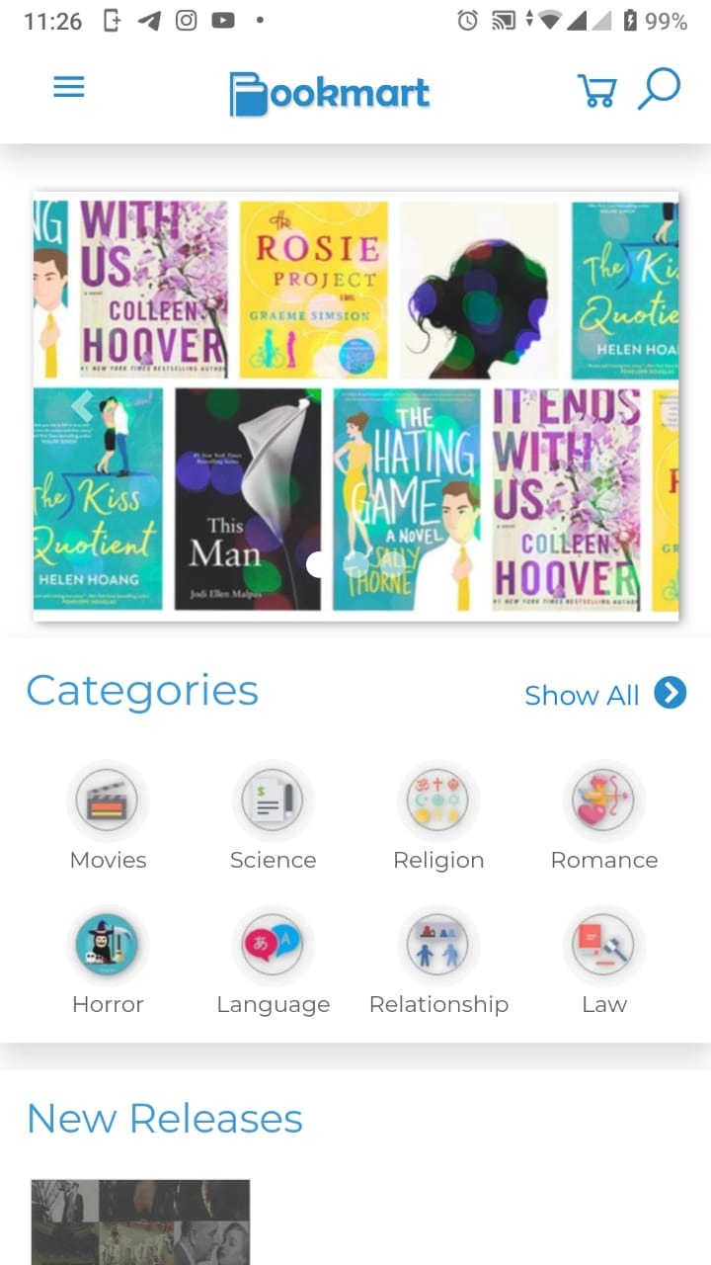
Home
Home for user which connected to another features, include Categories and New Release Products.

Slide 15
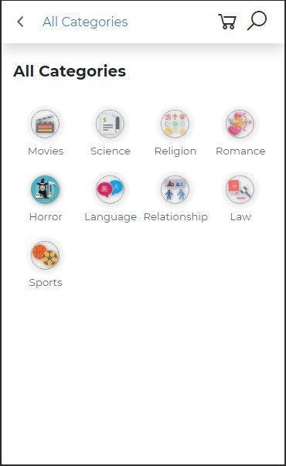
Categories
Display all available categories.

Slide 16
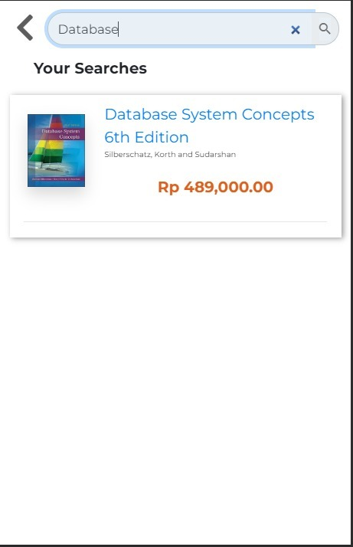
Search
Search for product by keyword.

Slide 17
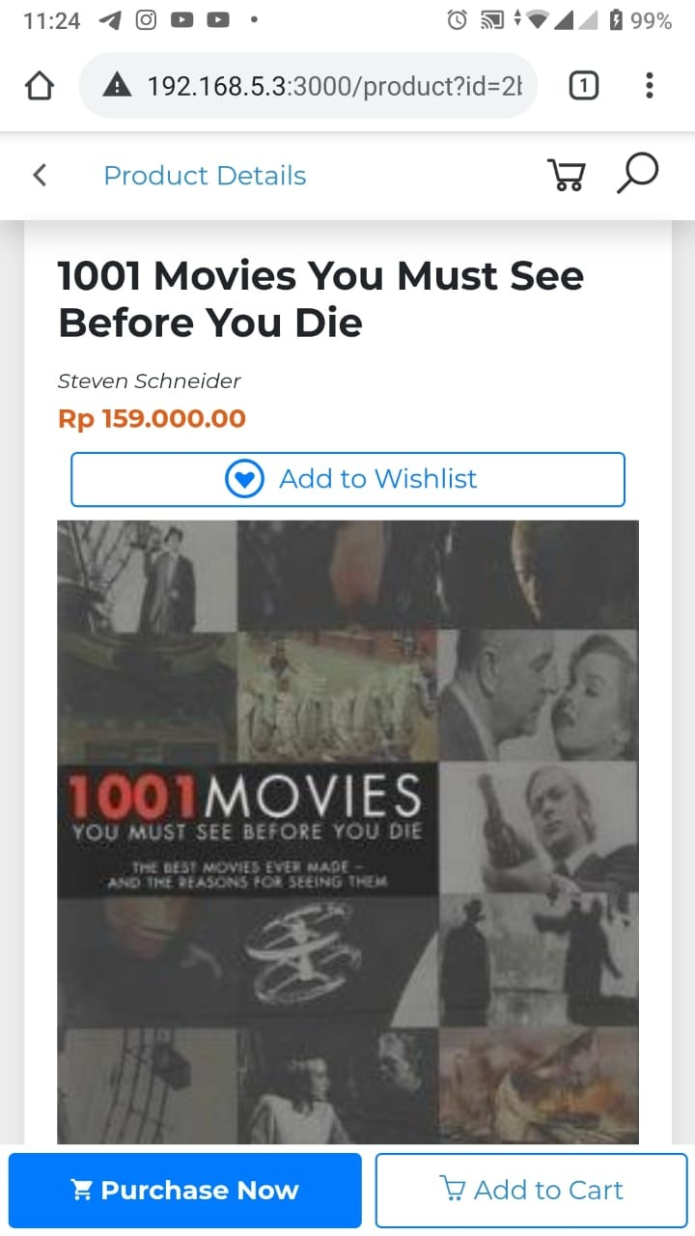
Product
Display information of a product.

Slide 18
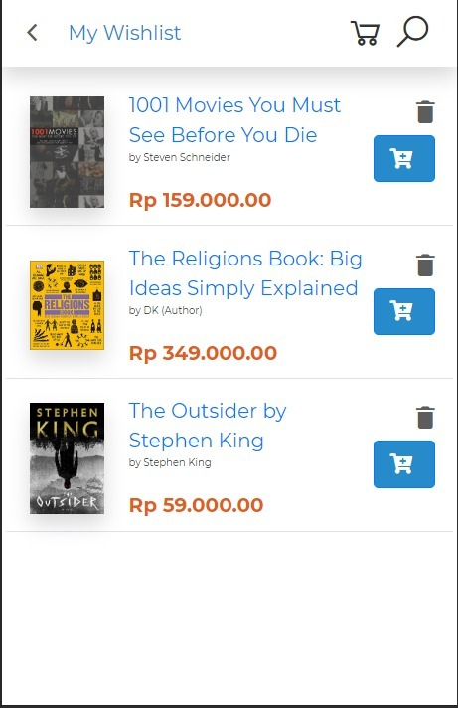
Wishlist
Save user’s favorites product.

Slide 19
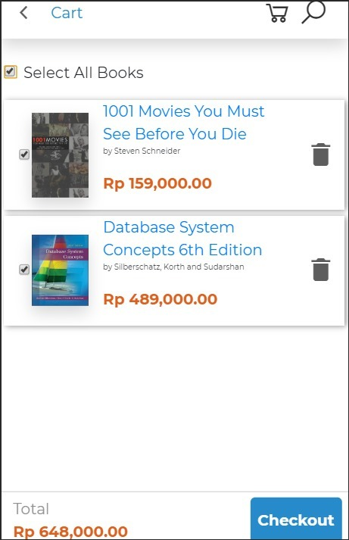
Cart
Display all products saved in cart and total price.

Slide 20
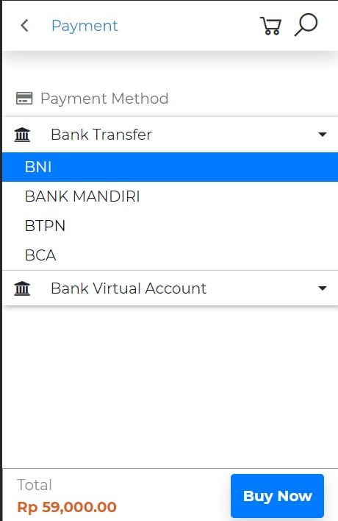
Payment
Select payment method for ordered products.

Slide 21
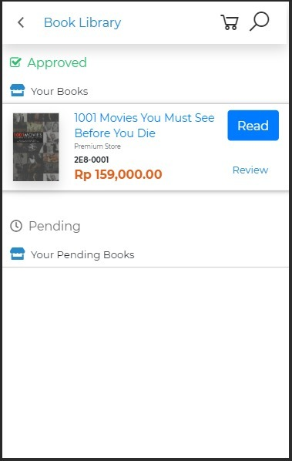
Book Library
Display all products purchased and ordered.

Slide 22

Read PDF
Load your books in browser.

Slide 23
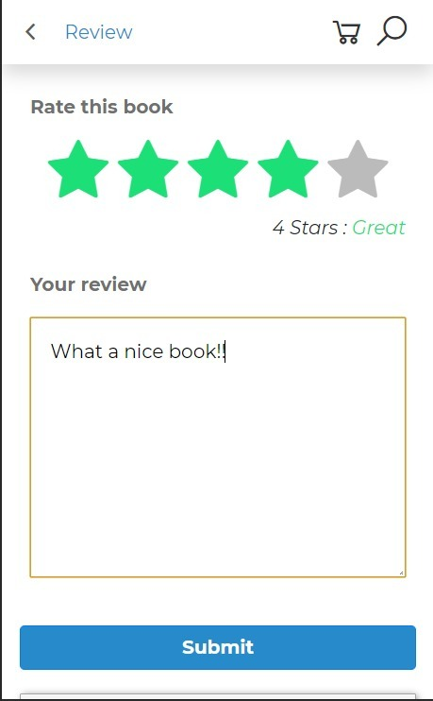
Review
Review ordered books.

Slide 24
Merchant
I can add my products
I can edit my profile
I can receive incoming orders.

Slide 25
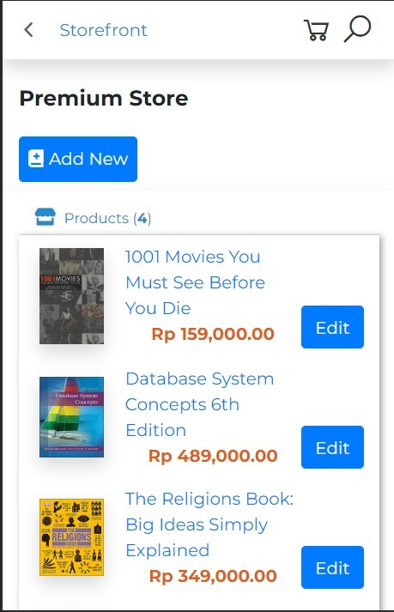
Place your screenshot here
Storefront
Display merchant storefront, products from merchant, and update products.

Slide 26
Admin
I can access master page
I can block user/merchant.

Slide 27
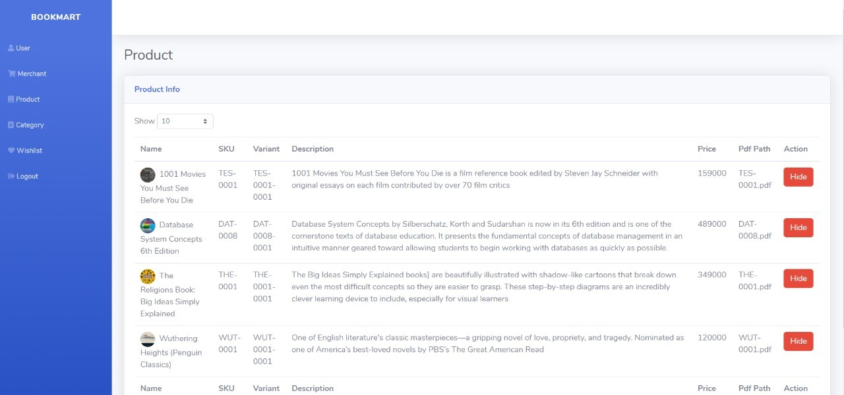
Master Page Admin
Display all master data, and block user / merchant feature.

Slide 28
Documentation
List of Used Technology
SRS Document
ERD
API Specs
Mockup
JQuery
Axios
Page.js
PDF.js
Lodash
Java Spring Boot
Sonar Qube

Slide 29


